Slide 1
High Level Project Overview
Composite Work Cycle
…
Composite Work Cycle: a reduced set of machine operations performed at some level of severity chosen to result in a machine experience that represents the desired portion (currently 90% severe) of the field population for design, simulation or validation of specific L4 and L5 systems.
Severity Quantification Development
Characterize Severity
Basic App Profile
Application Profile: a list of specific applications a machine or product performs, and the percentage of time spent doing each specific application.
…
Data Seg Algorithm Modeling
Segment Data
Resolve Application
Low Level Data
Pre-processing Development
Pre-Process
Data
Application Resolver Development
Raw Field Data
Notes:
Standard Definitions
·Operation: a relatively short, specific event or activity that a machine performs. Also referred to as a data segment, or operational segment. Example: dig, dump, load, carry, spread, rip, etc.
·Application: a relatively long, generalized task that encompasses one or more operations and describes the purpose for which the machine is being operated. Sometimes referred to as a cycle if the application is cyclical in nature. Example: production dozing, ripping, finish blading, stock-piling, etc.
·Application Profile: a list of specific applications a machine or product performs, and the percentage of time spent doing each specific application. Example: See the REDI “Machine Appl Prof” collection, and Caterpillar’s Business Intelligence Group’s database.
·Severity Characterization: a portrayal of how intense or acute an event was relative to the structural, kinematic, or dynamic physical response of an L4 system. If an operation is “what” the machine was doing, then severity is “how” it was performed. Severity can be measured or inferred in a variety of ways. Example: A dig event may incur a FELA value for a specific load of 200, a ripping event may incur a fatigue damage spectrum array with differing magnitudes for each frequency bin, etc.
·Composite Work Cycle: a reduced set of machine operations performed at some level of severity chosen to result in a machine experience that represents the desired portion (currently 90% severe) of the field population for design, simulation or validation of specific L4 and L5 systems. Operation information, along with severity characterization, is input for a composite work cycle. Example: See the REDI “Machine Appl Prof” collection, for example the CWC for D10T structures which includes 20% ripping, 5% travel ripped rock, 55% dozing ripped rock, and 20% pioneering.

Slide 2
Classification: Supervised Learning Model
Training Data Values
Extracted /
Transformed
Features
Machine
Learning Algorithm
Classification: Place an unknown
object in a bucket of
knowns
Labels
Build the Model
Deploy the Model
New Data Values
Extracted /
Transformed
Features
Predicted Label
Predictive Model
Notes:
SVM – Support Vector Machine
Currently Coded in Python

Slide 3
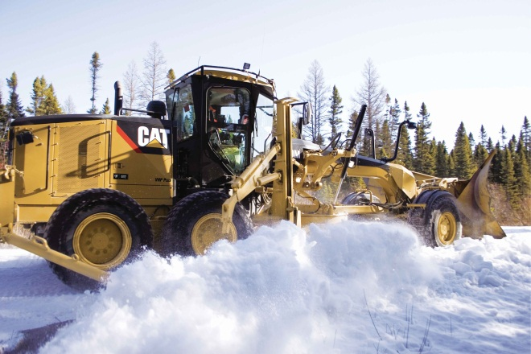

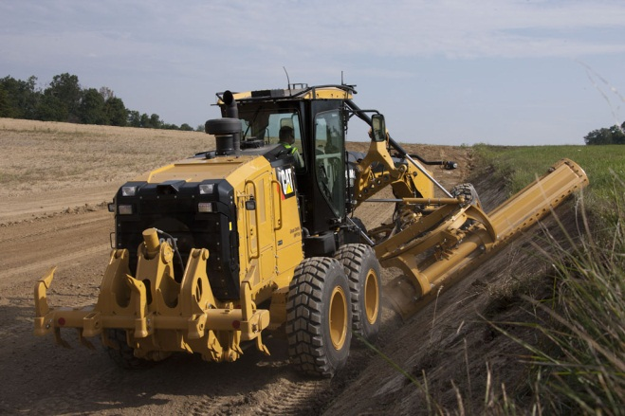
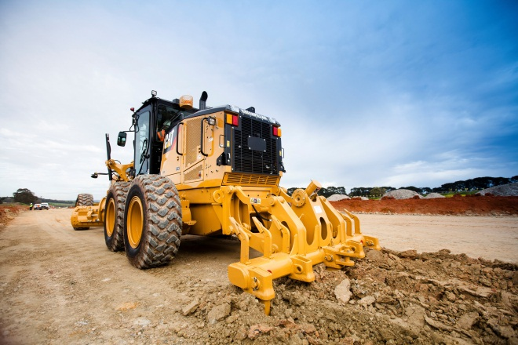
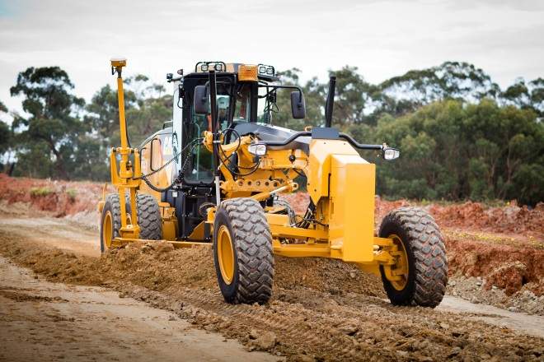
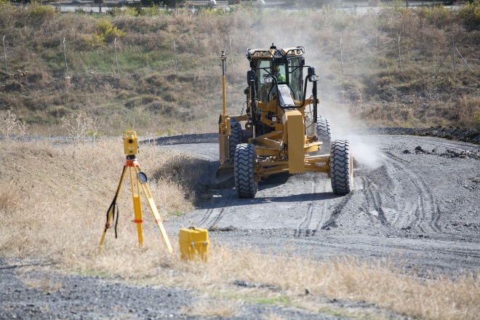
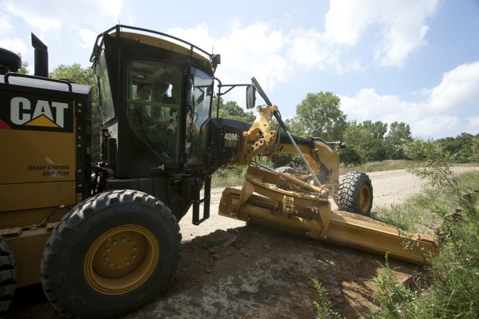
Motor grader case study

Slide 4
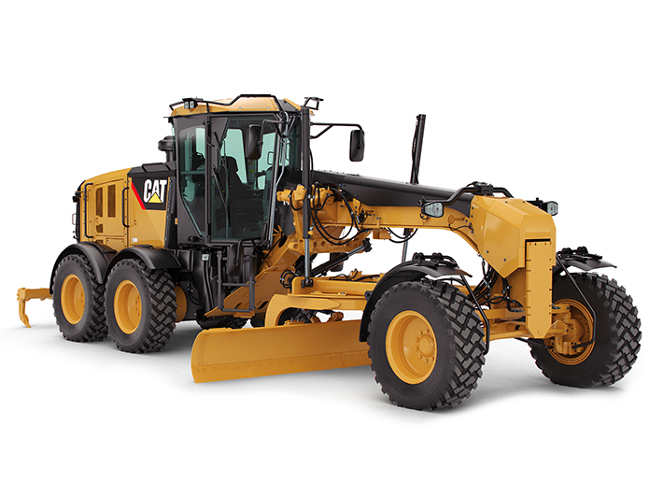



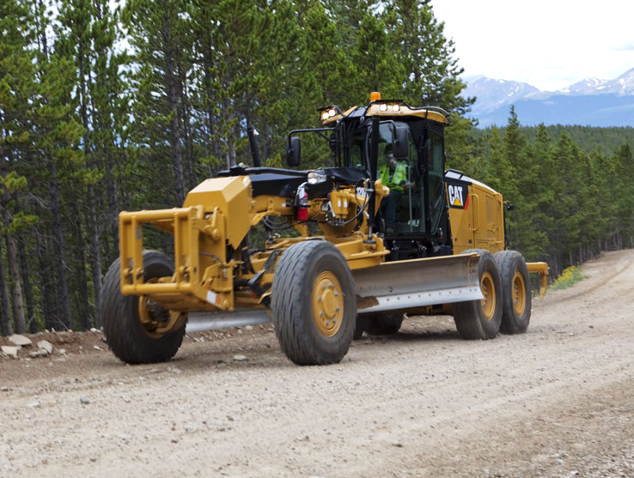
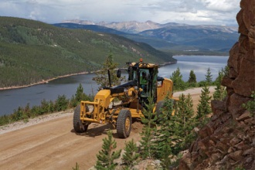
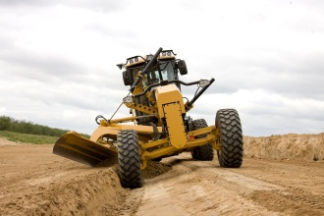


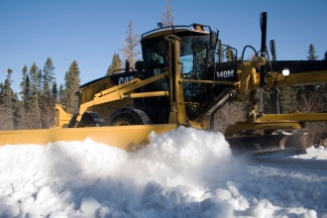
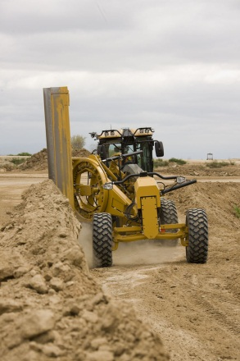
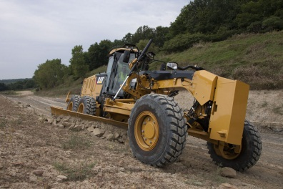
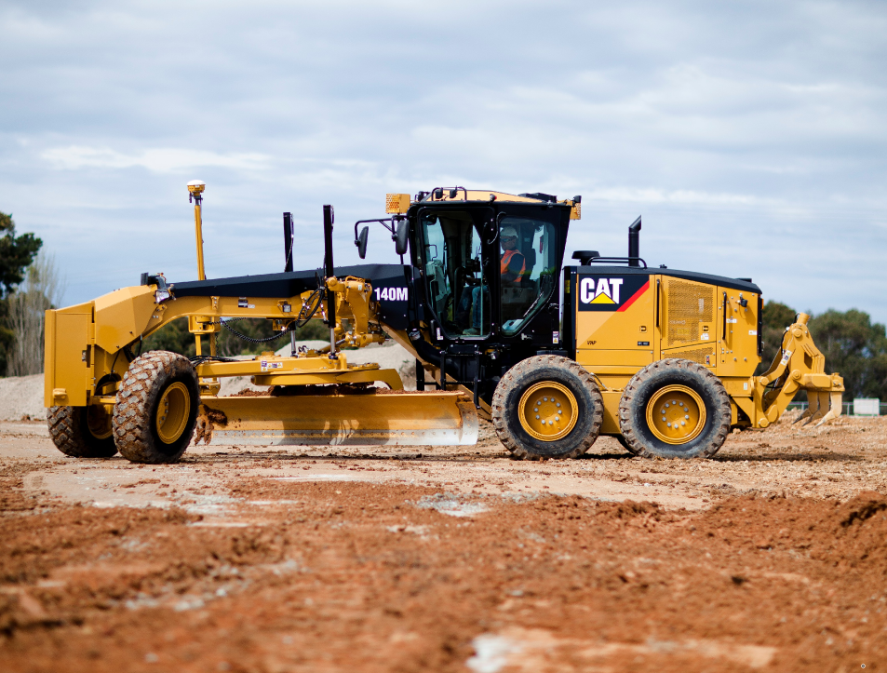
Application Channel Development Approach
Idle
Finish Blading
Heavy Blading
Ripping/Scarifying
Roading
Road Maintenance
Ditch Building
Ditch Cleaning
Snow Plowing
Snow Removal
Blade Slope Work
Side Slope Work
Travel*
Version 1
Version 2
Version 3

Slide 5
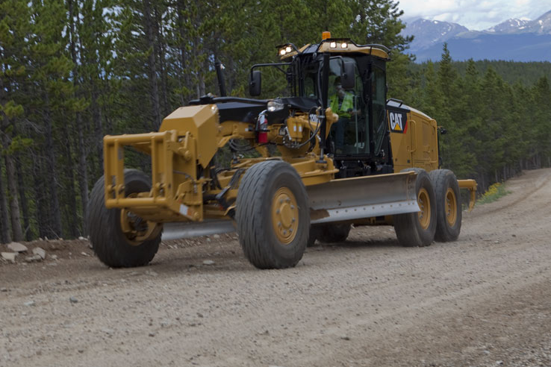
Application Channel Results
95%
Goal
Idle= 97%
Finish Blading
90%
Ditch Cleaning
Roading= 88%
Heavy Blading = 84%
Ripping/Scarifying= 84%
80%
SVM Predicted Application Accuracy
Ditch Building
70%
Snow Plowing = 74%
Road Maintenance = 71%
Blade Slope Work
Snow Removal = 67%
Travel= 63%
Side Slope Work
60%
Still Under development

Slide 6
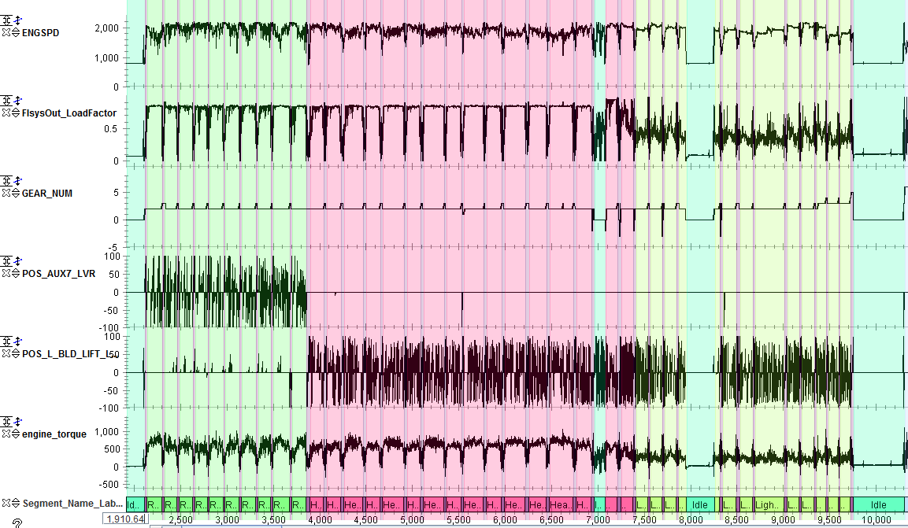
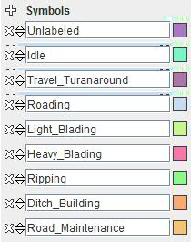
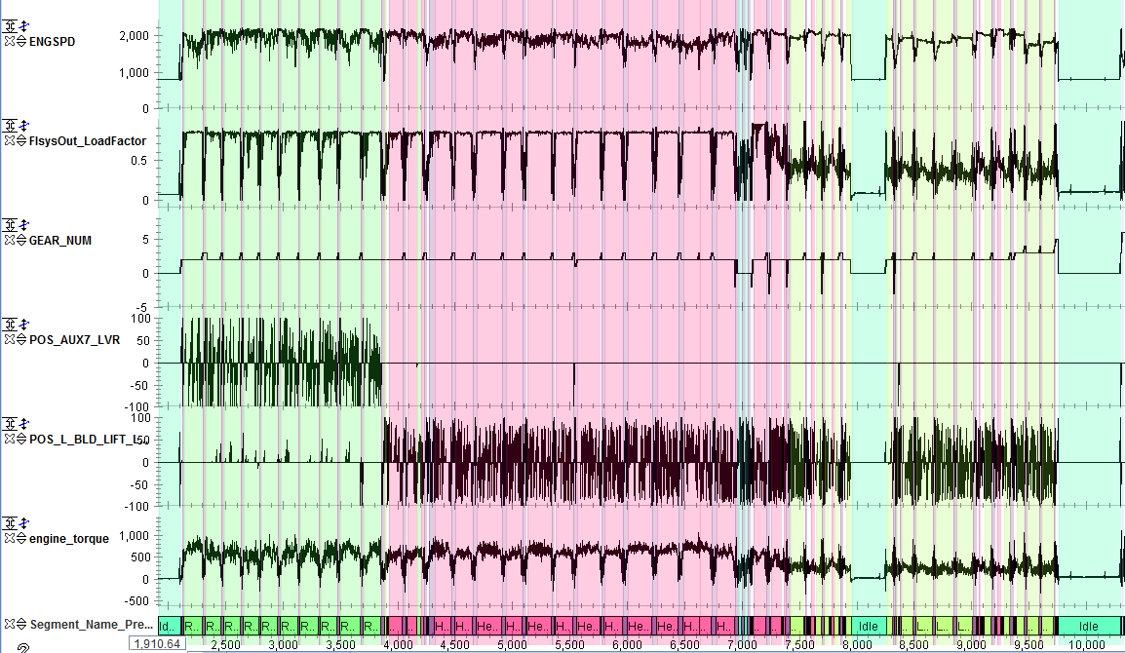
Applications Labeled vs. Predicted
Labeled
Micro Application – SVM Predicted Applications

Slide 7
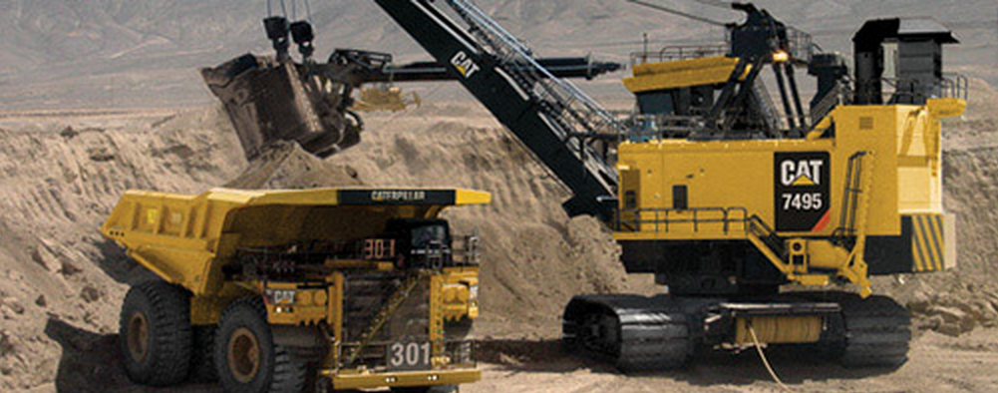
ELECTRIC ROPE SHOVEL case study
Notes:
Machine Overview:
Low Volume
High Productivity – 120 tons per pass
No Engine, all electric
Straightforward Cycle: Dig, Swing to Truck, Dump, Swing to Bank
Small amounts of movement (propel) between cycles. Max speed = 1 mile/hour

